Slide 1

PG Management System
Theme- SDG Goal 11 – Sustainable Cities and Communities
Category- Software
Group No - 3
Group Members- Swayam Rout, Aditya Salvi, Dhruv Ranim, Tanmay Repale
Guide- Prof.Adesh Hardas

Slide 2
Introduction
Background & Importance
Rapid growth of Paying Guest (PG) accommodations in urban areas
Most PGs still use Offline rent records, this leads to Data loss and Lack of transparency.
Supports SDG 11 – Sustainable Cities and Communities
Promotes organized urban living
Encourages digital infrastructure

Slide 3
Introduction
Current Challenges
Manual tenant record management: Time taking process to note down all the records.
No centralized complaint tracking: Manual communication can cause loss of details and forgetness.
No lifecycle tracking (Active / Notice / Left): You don’t have a proper data who was or will be in your PG.
Lack of transparency between tenant and admin
Security risks in storing personal data: The admin should not be able to see the passwords, that is inevitable in a traditional PG System.

Slide 4
Introduction
Motivation
Need for transparent PG administration: Both admins and the tenants should be able to see relevant information for transparancy.
Reduce paperwork and human errors: No more manual tiem consuming writing or reading. Just normal scanning will be enough, time saivng and efficient.
Secure digital data handling: All the passwords are incrypted no loss of data with good password management.
Objectives
Develop a centralized web-based PG system
Implement secure authentication (bcrypt hashing)
Provide complaint tracking module

Slide 5
Literature Survey
Analysis of Existing Systems
Many PGs use Excel sheets or manual registers: Causes errors and data loss.
No integrated complaint resolution system: Even if tenants complains there is no proper proof and it can be ignored by the admins or the admin can forget.
No lifecycle automation: No proper knowledge of who is and will be in your PG.
Lack of real-time data access
Weak authentication mechanisms: If the tenants is actually a tenant in your PG the access should be denied if the authentication does not matches but this cannot be done in traditional methods.

Slide 6
Limitations of Existing Systems
Paper-based data storage: No proper storage of data. You cannot possibly able to see and read all the records and not do mistakes.
No centralized database: There is no proper way of storing the details. Its just a formality.
Manual complaint handling: Complains get ignored most of the time. There is not proof so there is nothing tenant can do.
No lifecycle tracking: You dont know if the tenant lived for how much time.
Data security vulnerabilities: If the register get stolen then all the data is lost without any back up.
No role-based access control: Anyone with the register can see the details of all the individual and it does not matter. There is not protection here.

Slide 7
Literature Survey
Author / Source | Technique Used | Platform | Key Results | Limitations
MySQL Docs | Relational DBMS | MySQL | Structured data storage | Requires backend integration
Node.js Docs | Event-driven backend | Node.js | Fast server-side processing | Needs security implementation
Express.js | REST API framework | Express | Easy routing | No built-in authentication
bcrypt | Password hashing | Node.js | Secure password storage | Adds computational cost

Slide 8
Problem statement and Objectives
Problem Statement
Existing PG management methods are manual, inefficient, and insecure
Lack of centralized system leads to poor transparency and delays
Need for secure, automated, web-based solution
Project Objectives
Centralize PG operations
Implement role-based access (Admin / Tenant)
Enable complaint monitoring

Slide 9
Proposed Methodology
Tenant Module
Registration: Tenant themselves will register no manual writing details here.
Login (bcrypt hashed password): The password entered by the tenant will be hashed no admins can see it and access their portal no admin power use.
File complaint: FIling complain will actually go to admin and no ignorance here. You will have to proof.
Apply notice: Notice for leaving the PG this will ensure a lifecycle of the tenant in your PG. They can apply directly from their portal.
View tenure status: Tenants can see how much time does athey have left in their PG.

Slide 10
Proposed Methodology
Admin Module
View tenants: Admins can see the tenants details right when they login, and because of technology they don’t have to manually read to see the data.
Monitor complaints: Complaints are easy to access and cannot be forgetablle.
Update complaint status: The complain status can be modified by the admin to notify that the problem is solved.
Track lifecycle: Admins will be able to see the exact time interval the tenants was in their PG.
Manage rooms: Allocation of rooms are much quicker and efficient.

Slide 11
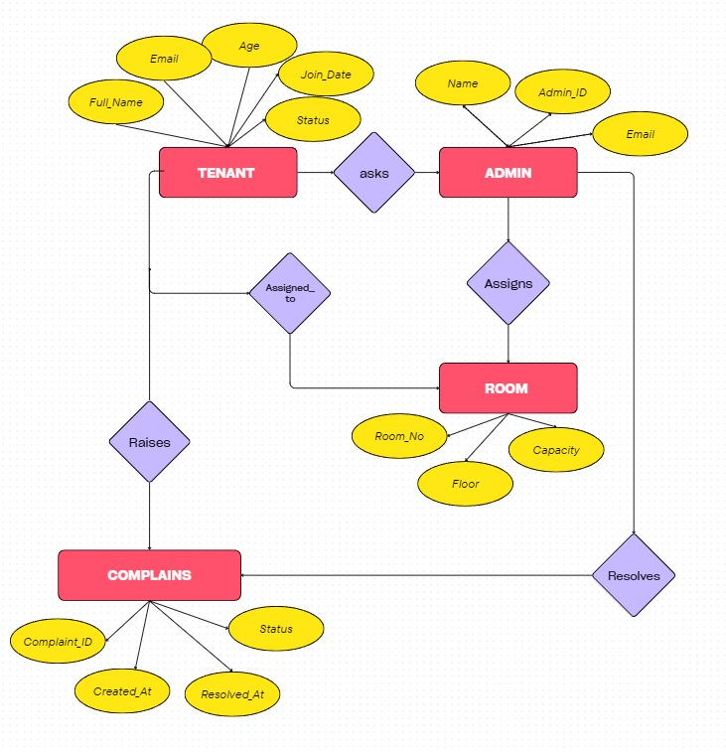
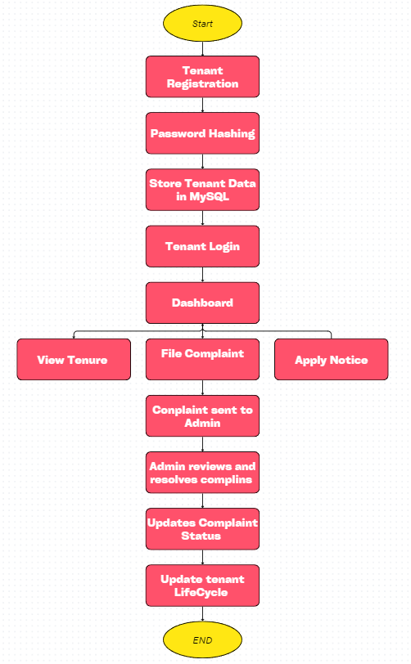

Slide 12
Experimental Setup
Software Used
Node.js : Used as a connection to all the backend database and the frontend. Using APIs
Express.js: Assistance the Node.js with the APIs
MySQL: Used as a database for storing the data.
HTML / CSS / JavaScript: For our frontend website and for our backend.
bcrypt library: Hashing of the passwords for privacy.
Dataset
Tenant details
Room details
Complaint records
Rent & tenure data

Slide 13
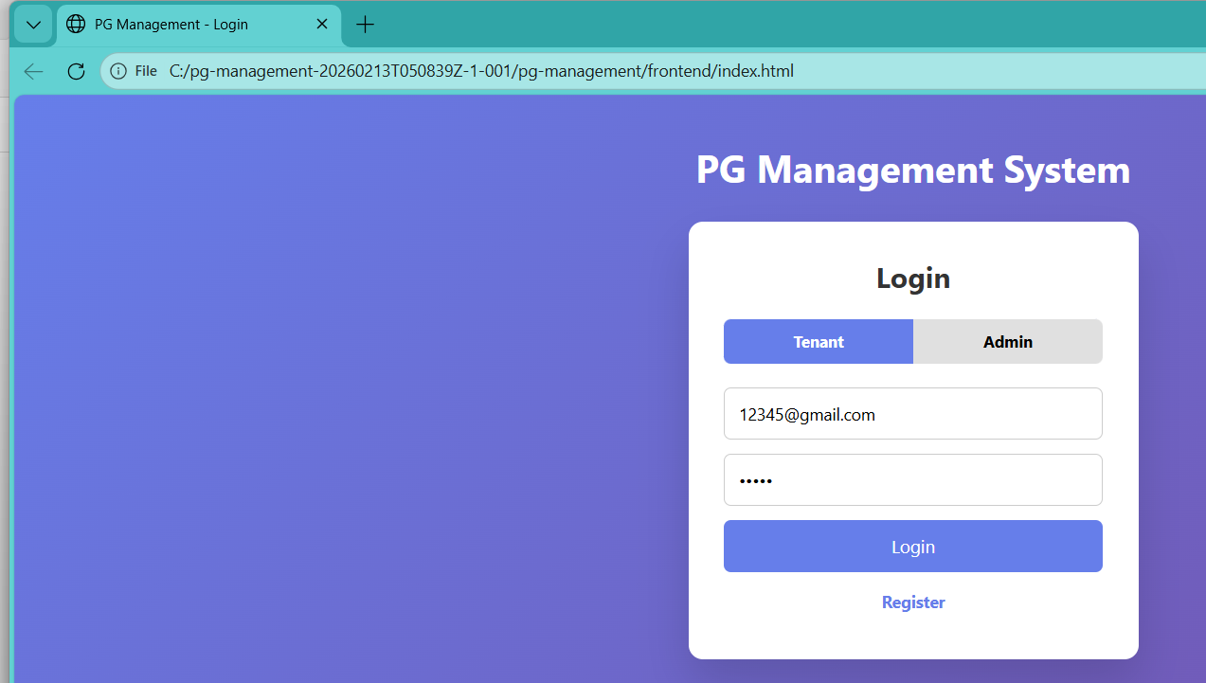
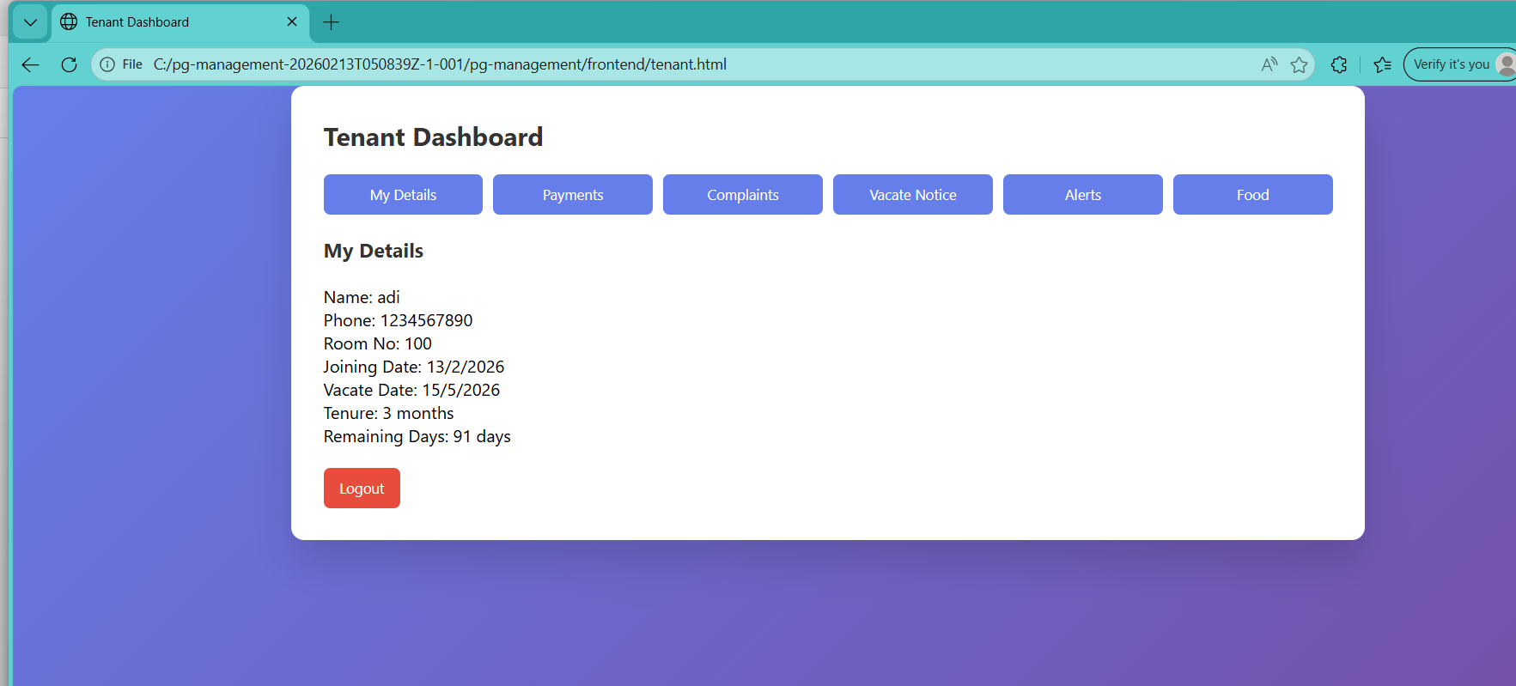
Implementation

Slide 14
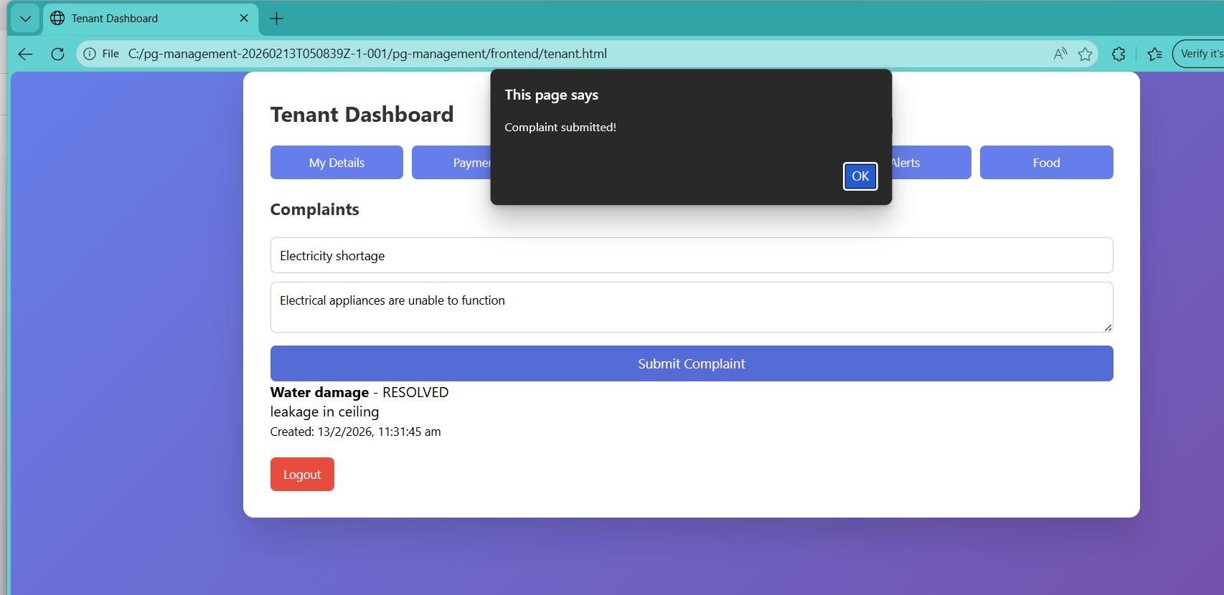
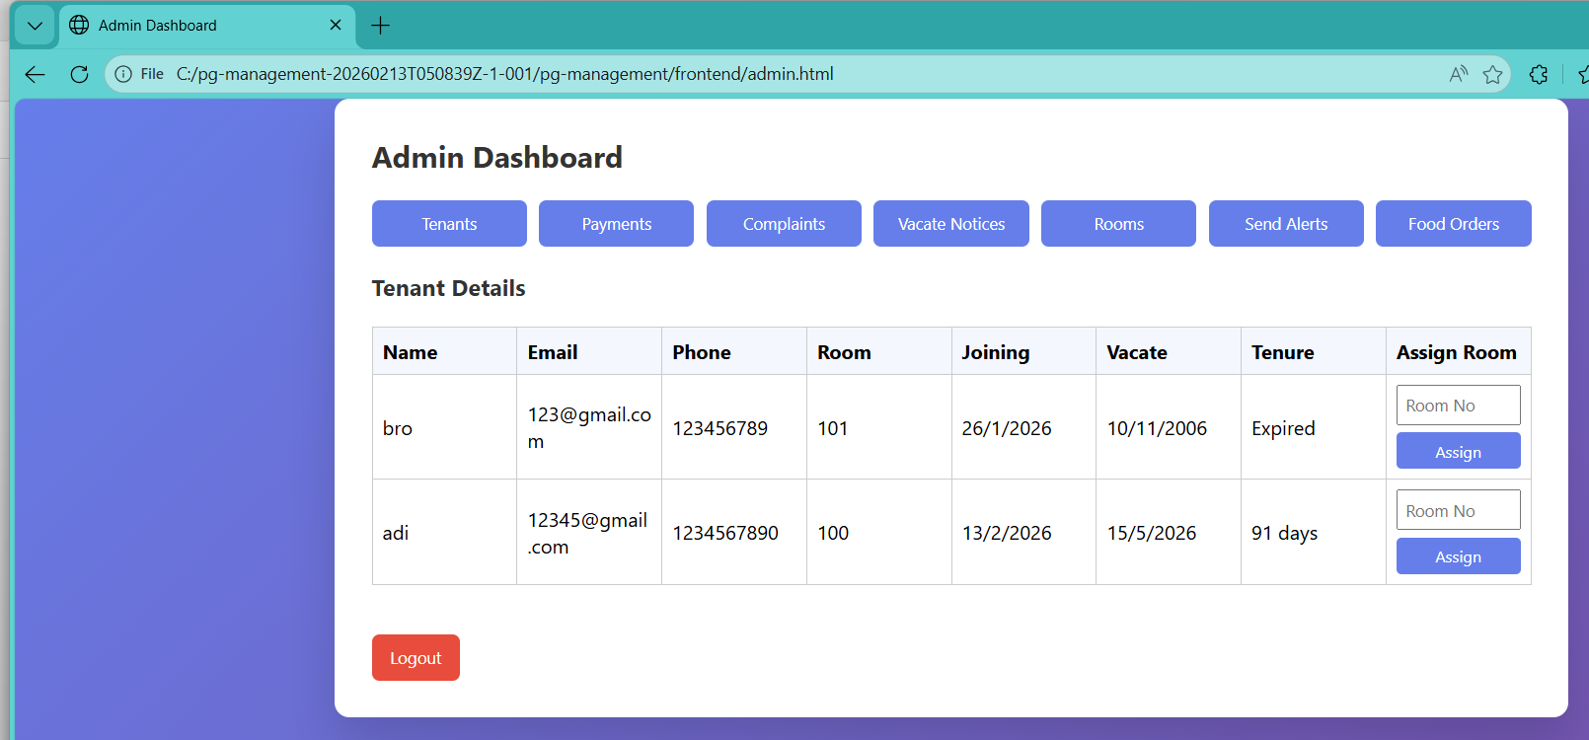
Implementation

Slide 15
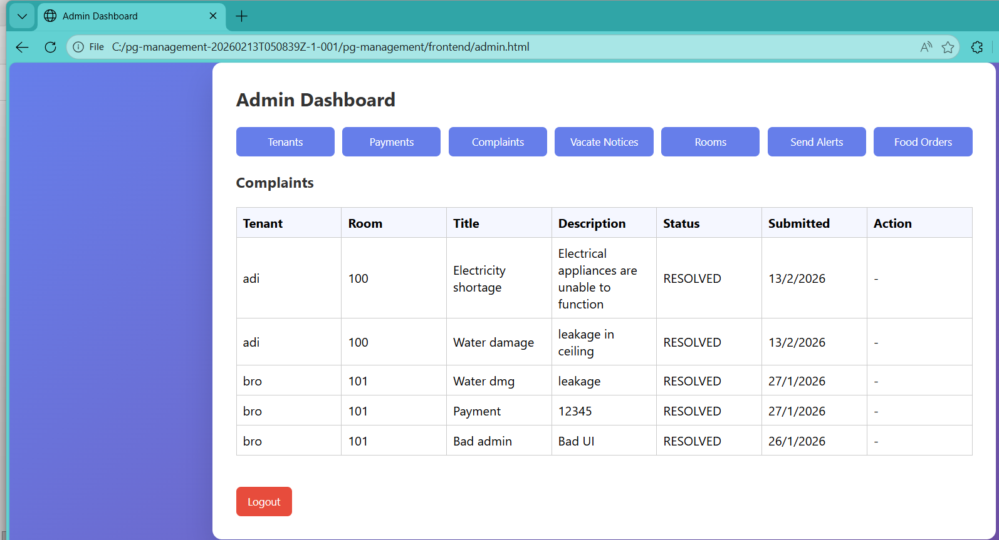
Implementation

Slide 16
Results and Analysis
Performance & Impact
100% Digital Record Storage
Eliminated paper usage
Reduced manual errors
Faster complaint resolution
Improved transparency

Slide 17
Results and Analysis
Feature | Manual System | Proposed System
Data Storage | Paper registers | Centralized DB
Security | No encryption | bcrypt hashing
Complaint Handling | Manual | Online tracking
Lifecycle Tracking | Not available | Automated

Slide 18
Conclusion and Future work
Conclusion
Successfully developed web-based PG management system
Improved efficiency and transparency
Achieved SDG 11 alignment
Secure and scalable architecture
Future Work
Online payment integration
SMS/Email alerts
Cloud deployment
Multi-PG scalability
Mobile application version

Slide 19
Research and References
Sommerville, I. (2011). Software Engineering (9th Edition). Addison-Wesley.
Royce, W. W. (1970). Managing the Development of Large Software Systems. Proceedings of IEEE WESCON.
Bassil, Y. (2012). A Simulation Model for the Waterfall Software Development Life Cycle. International Journal of Engineering and Technology.
Kirvan, P., Lutkevich, B., & Lewis, S. (2024). Waterfall Model – Definition and Guide. TechTarget.
GeeksforGeeks. (2026). Waterfall Model in Software Engineering.
Rastogi, V. (2015). Software Development Life Cycle Models and Methodologies. International Journal of Advanced Software Research

Slide 20
Thank You...!!

